Slide 1
WWWWWwWHYw
Why windows vista SUCKS!!!!

Slide 2
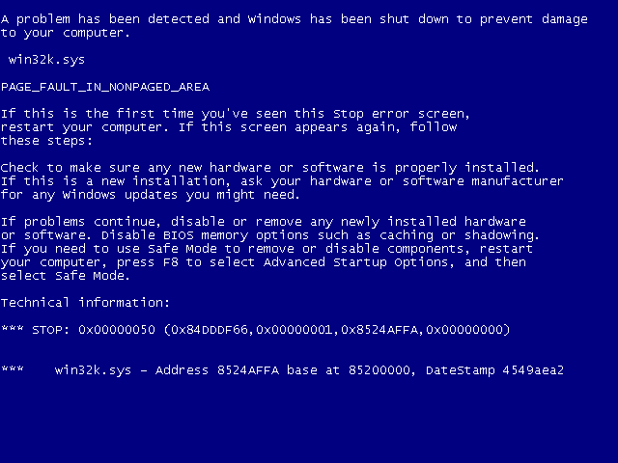
REASON
REASON NUMBER 1:
IT CRASHES ON ME ALL THE TIME
THE WINDOWS VISTA DESKTOP!!!!!!!!!!!!!! --→

Slide 3

REASON NUMBER 2:
MY FRIEND JIMMY FROM DOWN THE STREET SAYS VISTA IS GARBAGE!!!!!
THAT’S MY FRIEND JIMMY →

Slide 4


REASON NUMBER 3:
MY VISTA CAPABLE PC ISNT ACTUALLY VISTA CAPABLE!!!!!!!!! ITS SO F**KING SLOW (SORRYFOR SWEAR WORD)
All lies!!!!
→

Slide 5
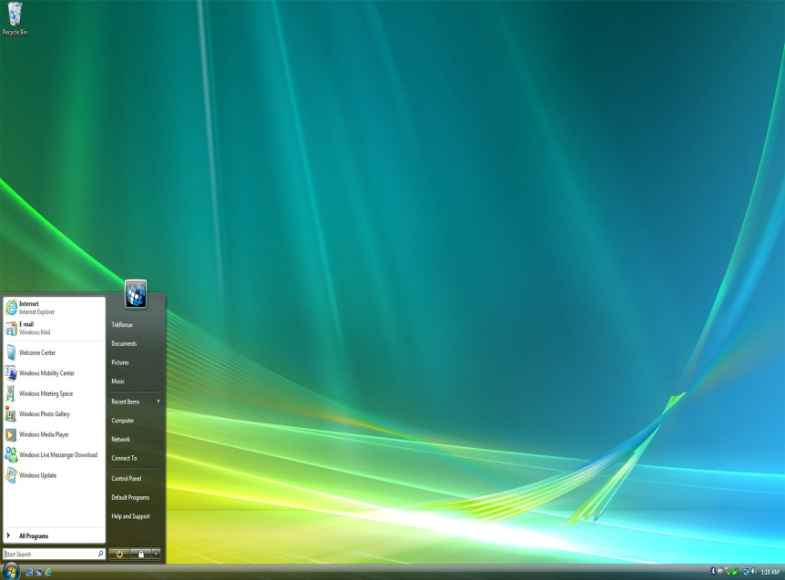
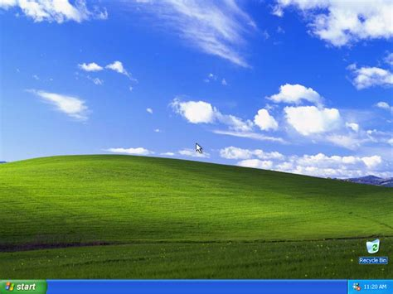


THANKS
Thanks for listenign
DO NOT EVRE UP GRADE TO WINDOWS VISTA!
COPYRIGHT 2007 JOHNATHAN

